Slide 1

Scoring Guidelines: HF-HRV

Slide 2
Overview: Steps to Scoring
Load in your data (.mwi file)
Set the channels
Make sure other settings are correct
Determine if ECG wave is inverted
Edit each 60 second segment
Write your data as you go
Save both the edit file and .csv
Notes:
Spectral window
Allows for continuous data to be analyzed (needed for FFT)

Slide 3
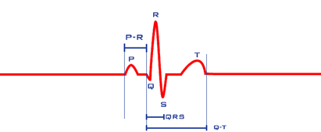
The ECG Waveform: Know How to Find R-Peaks
This will be pretty easy if your data is clean, but might be more difficult in noisy data
Look for sharp peaks followed by sharp troughs
R-peaks should be relatively evenly spaced (more on that later)

Slide 4
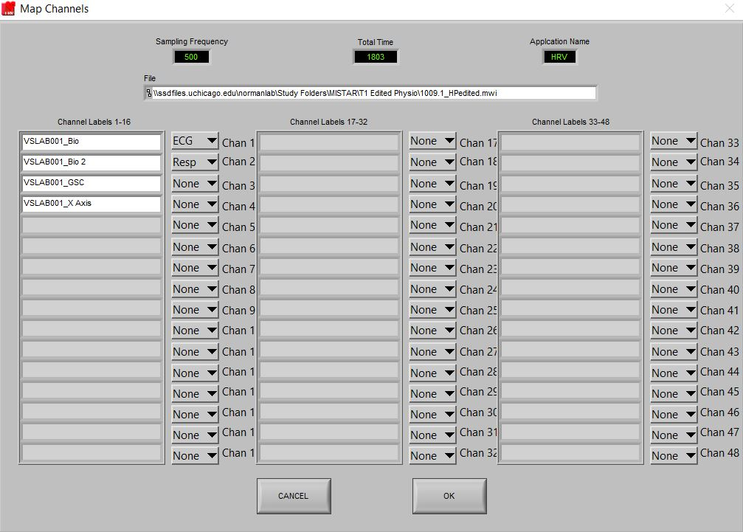
Setup: Load in a File
Set your ECG and Respiration channels right after you open the file

Slide 5
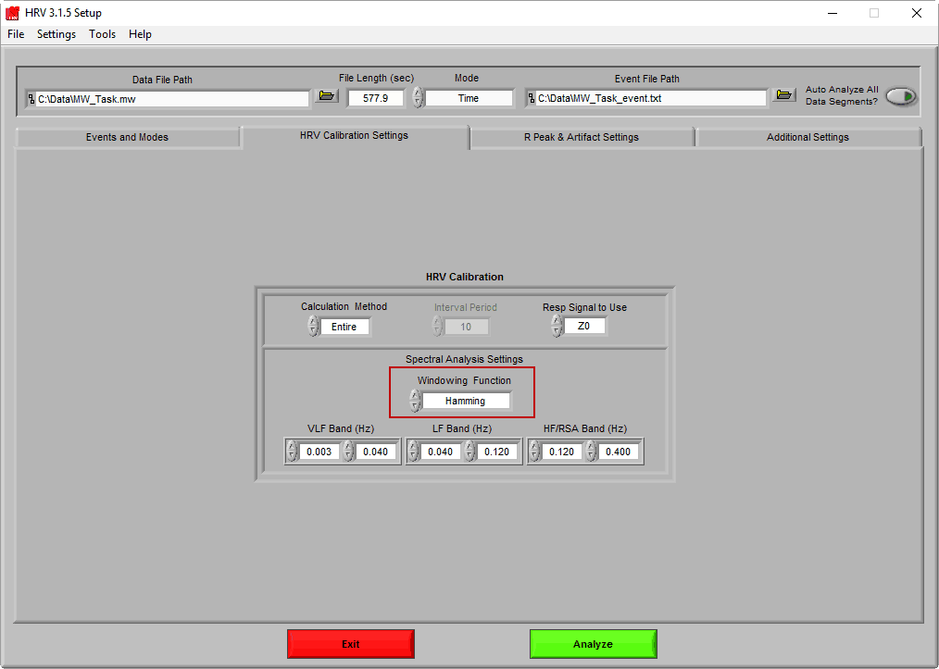
Settings: Hamming Window
On the “HRV Calibration Settings” tab
There are a few different windowing functions, but we use the hamming window (which is the most commonly used window)
Notes:
Spectral window
Allows for continuous data to be analyzed (needed for FFT)

Slide 6
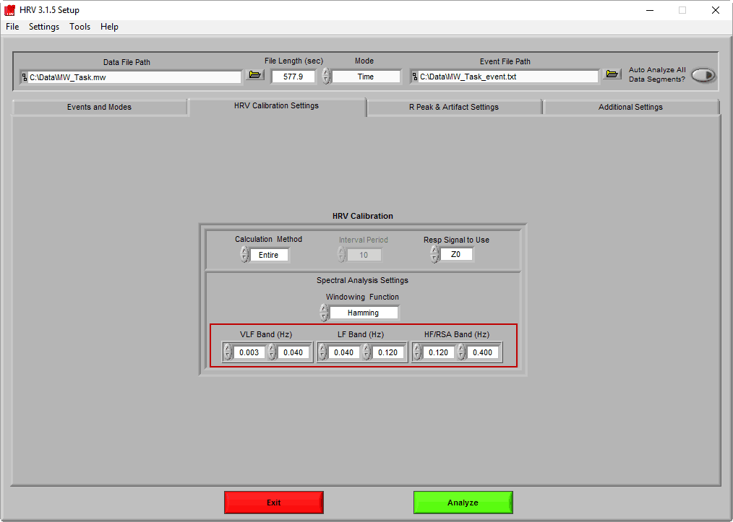
Settings: Frequency Bands
On the “HRV Calibration Settings” tab
Remember we are interested in the high frequency band
Make sure HF/RSA Band (Hz) is set to 0.120 – 0.400 Hz
If you are working with child data the HF/RSA Band (Hz) should be set to 0.240 – 1.04 Hz

Slide 7
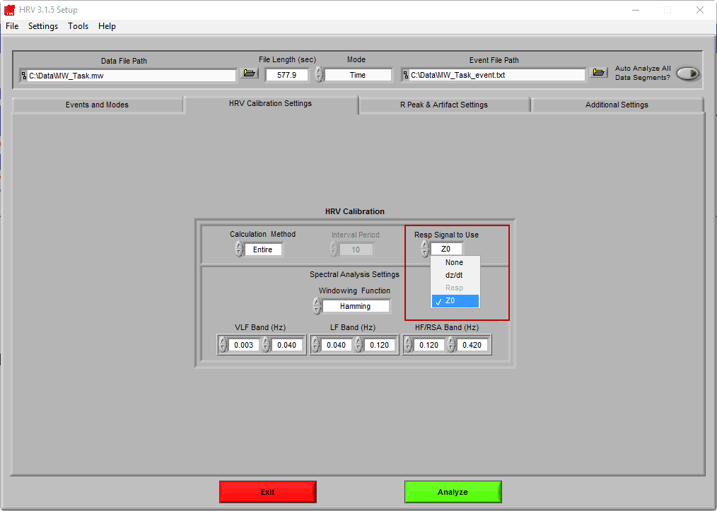
Settings: Respiratory Signal
On the “HRV Calibration Settings” tab
Set “Resp Signal to Use” to Z0

Slide 8
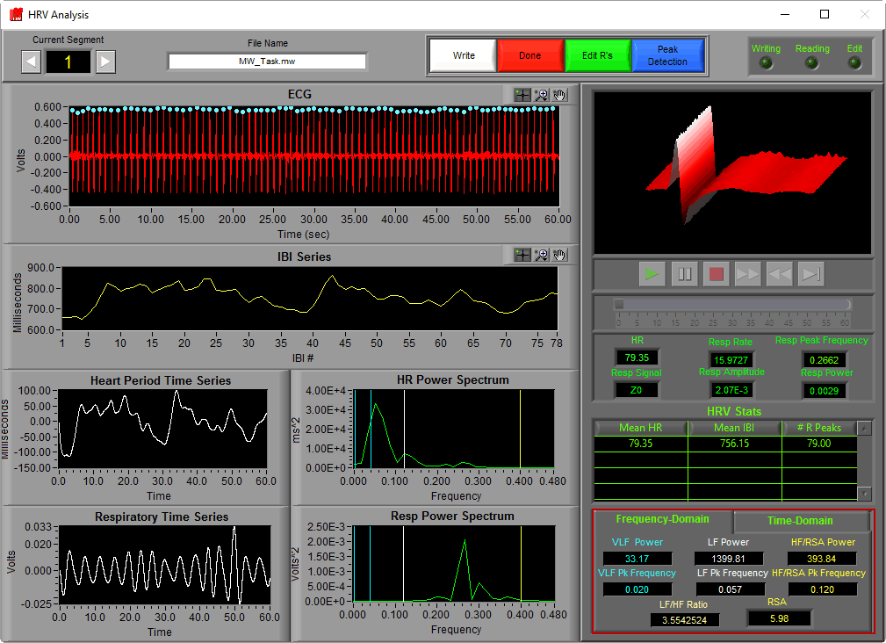
The Data
Correct R peaks will be labeled with BLUE DOTS
Incorrect R peaks will be labeled with YELLOW DIAMONDS

Slide 9
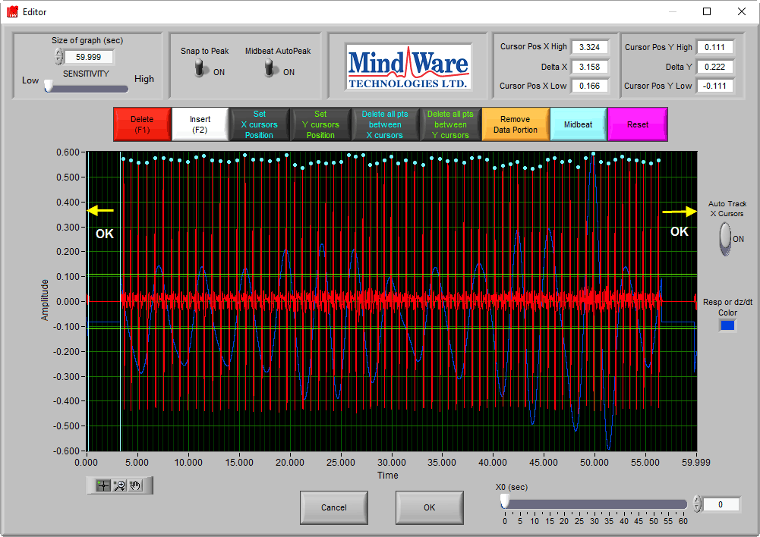
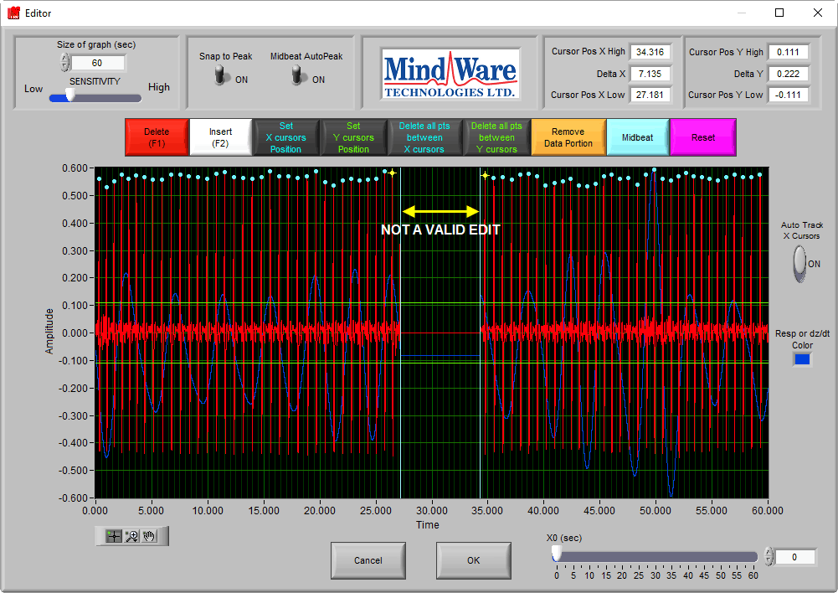
Rules For Editing: 30 Second Rule
You need at least 30 seconds of continuous data (this can be in the middle or at either end – it just needs to be 30 seconds without breaks!)

Slide 10
Rules For Editing: 10 Percent Rule
Don’t edit more than 10% of the segment.
This means if there are 60 beats, do not midbeats more than 6 R peaks.
If you need to edit more than 10% to keep the segment, discard that segment (aka don’t write it (aka don’t press “write” before moving on)).

Slide 11
Rules For Editing: Midbeats
Midbeats set the R peak as the average between two labeled R peaks
This edits the data by inserting points that are not necessarily present (essentially making up data using best guess algorithms)
Therefore do not make more than 2 midbeats in a row

Slide 12
Other Tips and Tricks (Or Just Things to Know)
Always zoom back out to make sure you aren’t missing any yellow diamonds
After you finish editing a segment, click “Write” to make sure it is exported to the .csv
Your files will save as edit files and .csv outputs

Slide 13
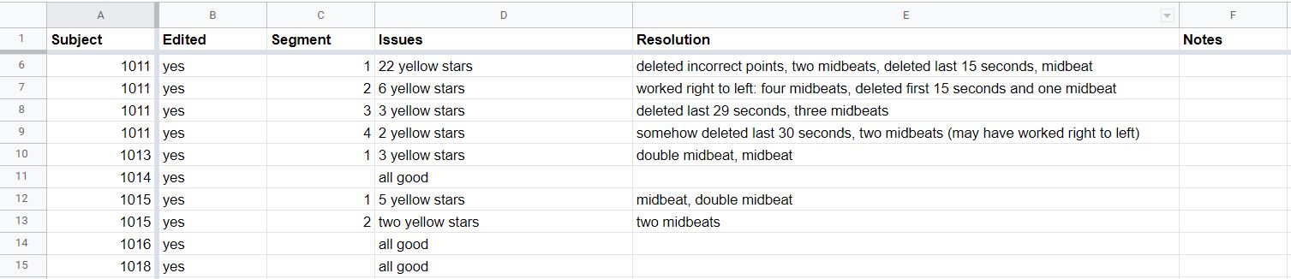
Keeping Notes
Keep track of the edits you make for each subject and each segment – this will be super helpful if you need to go back and re-edit or show anyone what you have done!
I like to use a Google spreadsheet, but find what works for you

Slide 14

Soon this will be you!

